Slide 1
Guidance Utility for Impaired Daily Experiences
Jack Letsinger, Jack Couture, Alyan Tharani, Diana Canchola, Ryan Wu, Noah Kilpatrick

Slide 2
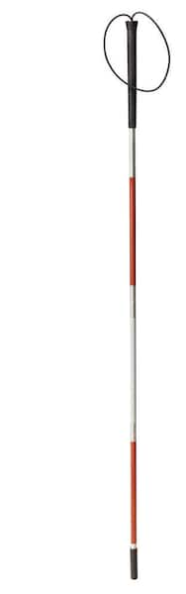
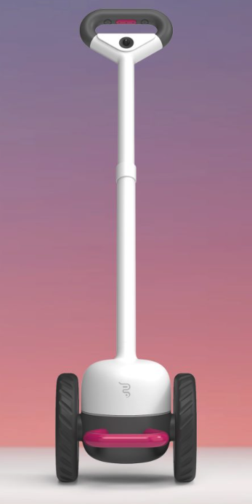
Problem
Development Timeline
1931
White Cane is formally recognized as a tool for the blind
1947
Collapsible cane is developed by Dr.Richard Hoover
Widely used
Little to no
innovation
Compromises:
compatibility
mobility
1921
White cane is invented by James Biggs
1935
The long cane is developed for navigation by Dr.Richard Hoover
21st Century
Adoption of electronic sensors
GPS
Ultrasonic
smart apps
Notes:
Alyan
Highlight there is a lot of movement in the early 1900s but then falls silent
We are seeing a lot of innovation with smart canes and sensors but it isn’t being widely adopted
The main problem is the widely used white cane hasn’t been innovated and is limited, the user doesn’t know about the obstacle until it is directly in front of it.
New canes compromise mobility and compactibility because they’re bulky and expensive

Slide 3
Need
21st century solution to a humanity-long impairment
Incorporate modern sensors and algorithms to provide a better picture of environment for the visually impaired
Full spatial awareness with real-time feedback
Device familiar to the users that will enhance their independence and quality of life
Notes:
Alyan
Main needs are for the user to have full awareness of their surroundings so they understand their environment better
We need to bring 21st century sensors and algorithms to a humanity-long impairment
Leverage a tool familiar to the users but enhance it so they can be more mobile and independent

Slide 4



Goals & Objectives
Detect obstacles up to 2m away from the user
Alert the user through the use of handle vibrations
At the 2m, 1m, 0.5m, and 0m distances
Allow the user to adjust the handle vibrations for sensitivity
Full Mobility
Detect Obstacles
Alert Users
Notes:
Ryan Wu
Three main goals for our project
Increase independence for the visually impaired by enabling full mobility in college campuses
Detect Obstacles 2m away from them
Alert users through handle vibrations, explain how the vibrations will change as the obstacle gets closer

Slide 5

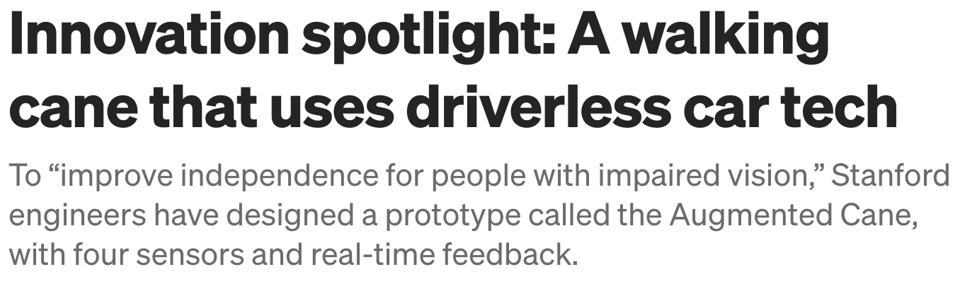
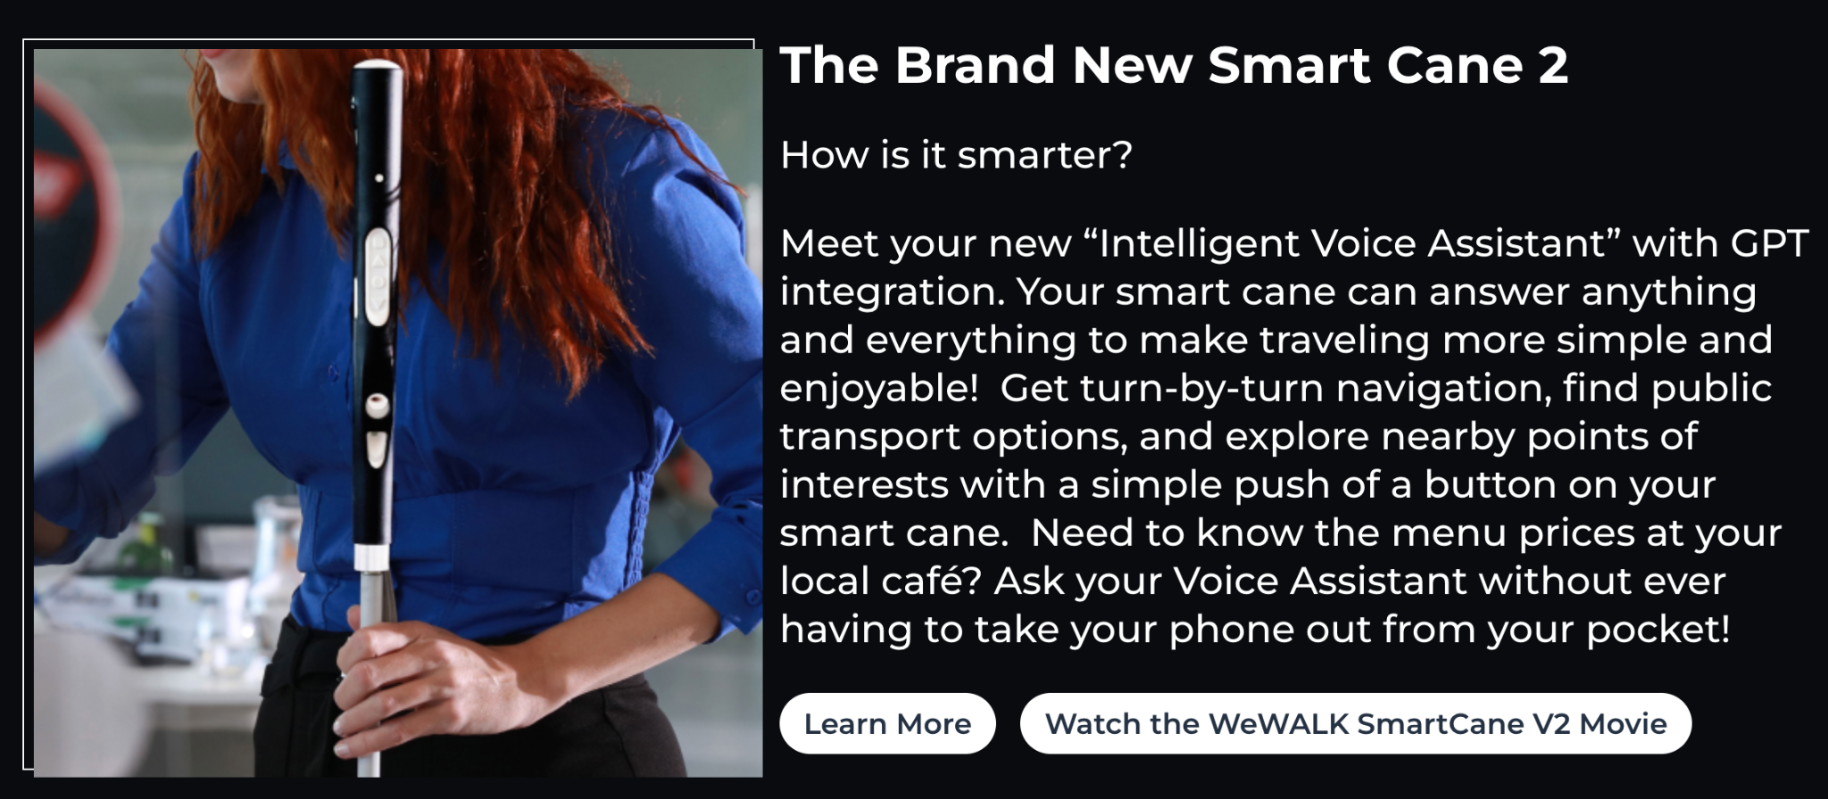
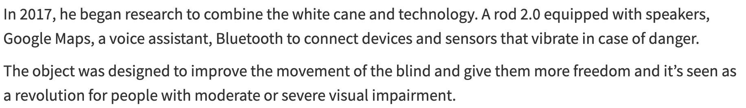
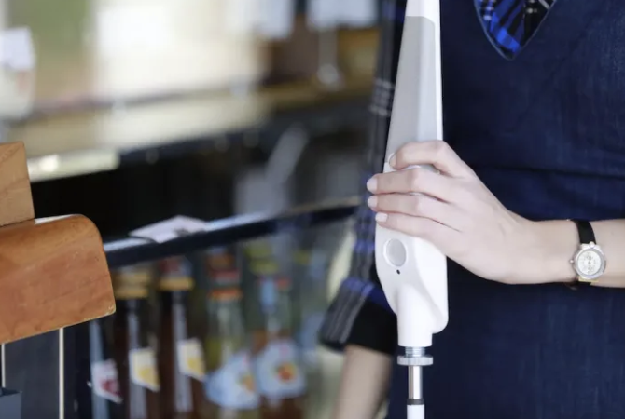
Literature Review
Website Link
Website Link
Website Link
Website Link
Notes:
Noah
Begin explaining how many believe the white cane is “unimprovable”
Not much innovation other than making is collapsable and painting it white for easy recognition
Explain solutions other companies have started investing in
WeWalk: AI Cane on pre-order for 6 years
Stanford Research: Augmented Cane with spatial orientation, distances, and GPS
Rod 2.0: Speakers, Google Maps, voice assistant, bluetooth

Slide 6




Design Constraints
Lightweight design for full mobility.
2 lb in total weight.
Durable battery life for day-long use.
3-4 hours of use in one charge.
Real-time feedback with little to no delay.
0.5 seconds or less of delay.
Size
Weight
Battery Life
Low Latency
Notes:
Ryan Wu
The design constraints are mainly focused around creating the best user experience without compromising functionality
Has to be a small addition to the cane to keep it collapsable and lightweight
Has to last at least 3-4 hours
Has to have near instantaneous feedback to the user about obstacles

Slide 7
Alternate Solutions
Smart Cane with phone app to audibly alert users of obstacles
Audio could impair hearing
SLAM Algorithm to add obstacles into a database
Stretch goal
Infrared Sensor for object detection
Access to other sensors
Belt or bag for users to carry along with the cane
Added baggage for users, eliminates portability
Notes:
Noah
These are ideas we had for the project but we didn’t add in
Discuss the pros and cons of each
1. Phone App
Pro: Have one place where the user could interface with the tool
Con: Audio could impair the hearing of the user and the people around them, the application would have to be accessible to the user
2. SLAM Algorithm
Idea behind this is to track the obstacles the user encounters to build a database and have the cane be smarter by knowing when to anticipate them
Pro: Makes our cane smarter
Con: We set this as a stretch goal if we have time
3. IR Sensor
Pro: Added sensor for increased awareness
Con: We already had access to a depth camera and lidar, pairing the two made most sense to get a picture and distance
4. Bag
Pro: Provide a way to store batteries and wires in a wearable way
Con: Added component for users that may be cumbersome

Slide 8
OUR SOLUTION

Slide 9
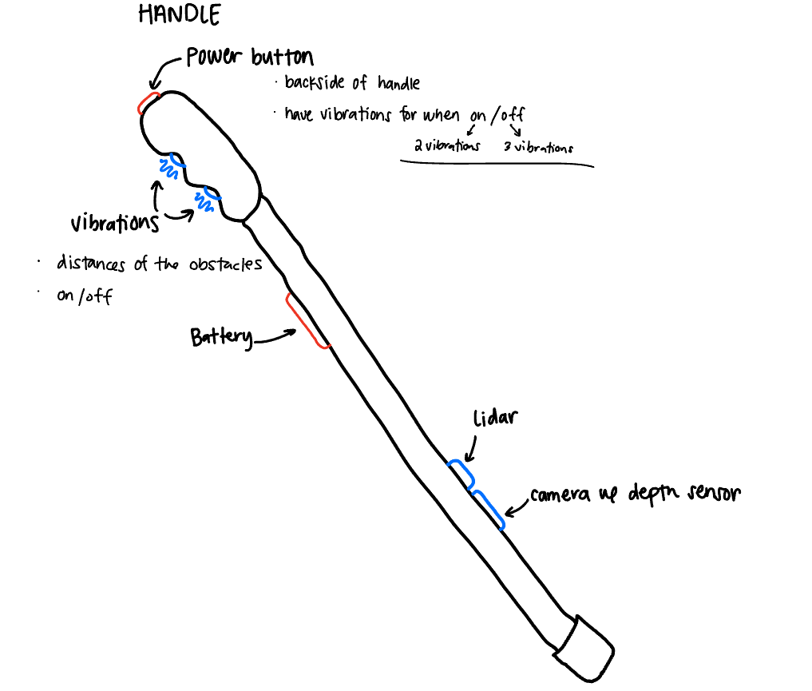
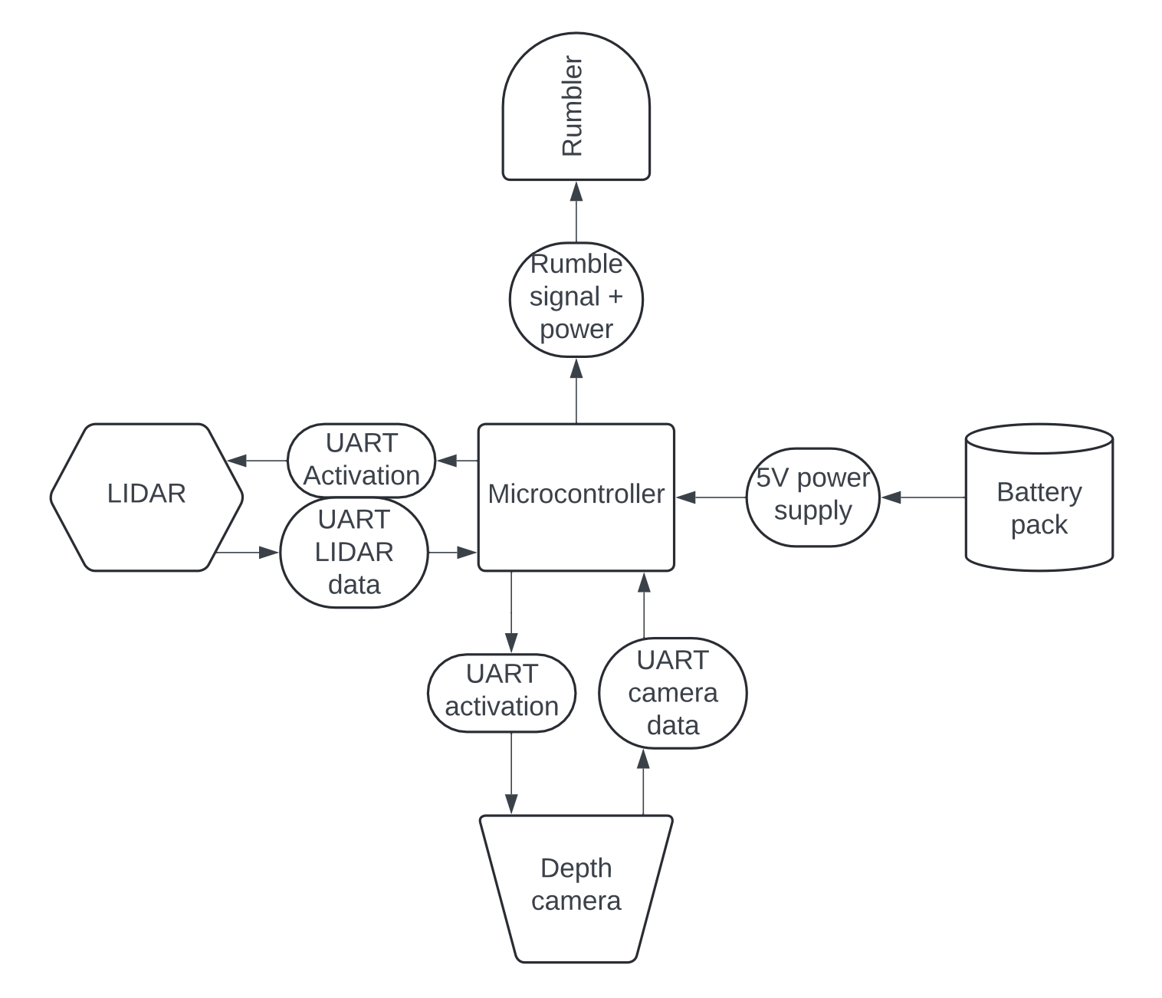
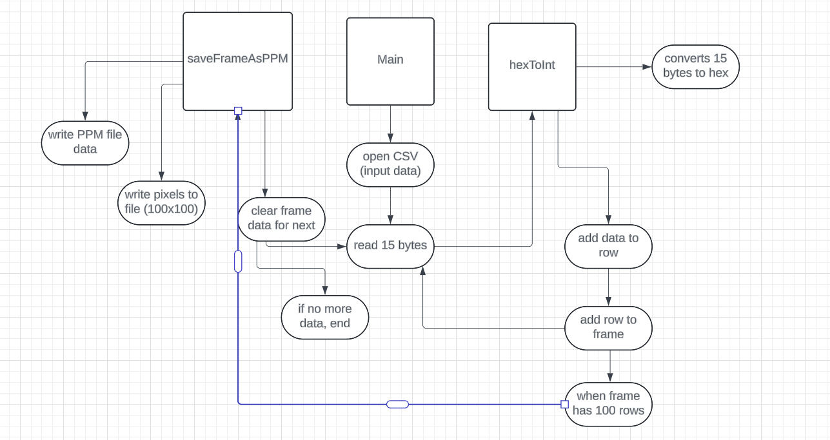
Proposed Design
Hardware Diagram
Software Diagram
Notes:
Jack & Jack

Slide 10
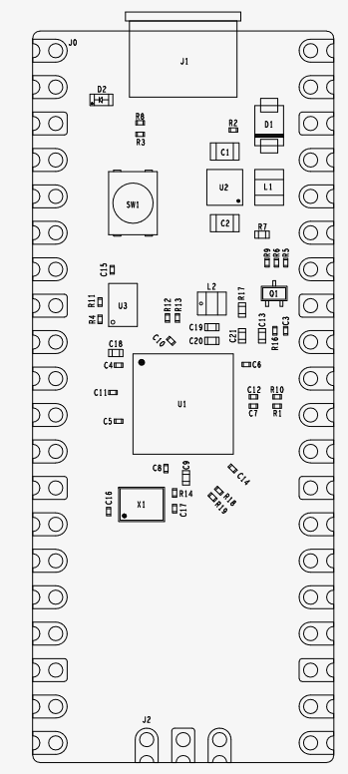
Hardware
The Use Case:
Sensors, brought together by a microcontroller, must:
Accurately paint a picture for the user
Be lightweight and easily transportable
Be energy efficient for a suitable battery life
While each piece of hardware and their codebase already exist, the effectiveness of the design will come from the integration of all components to a final product.
Notes:
Jack L

Slide 11
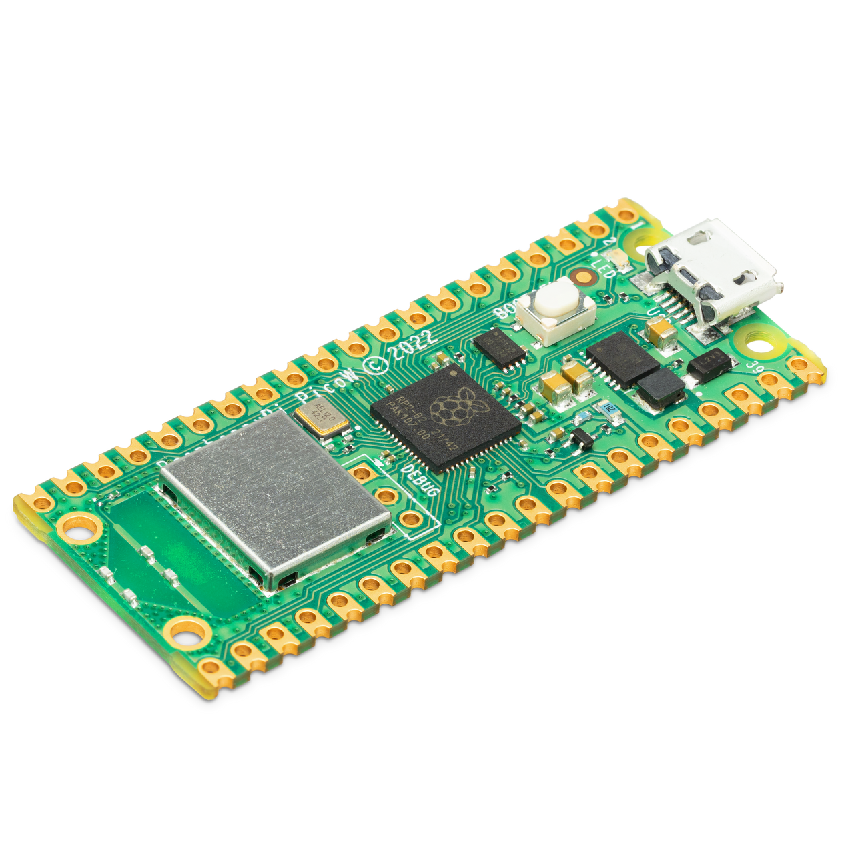
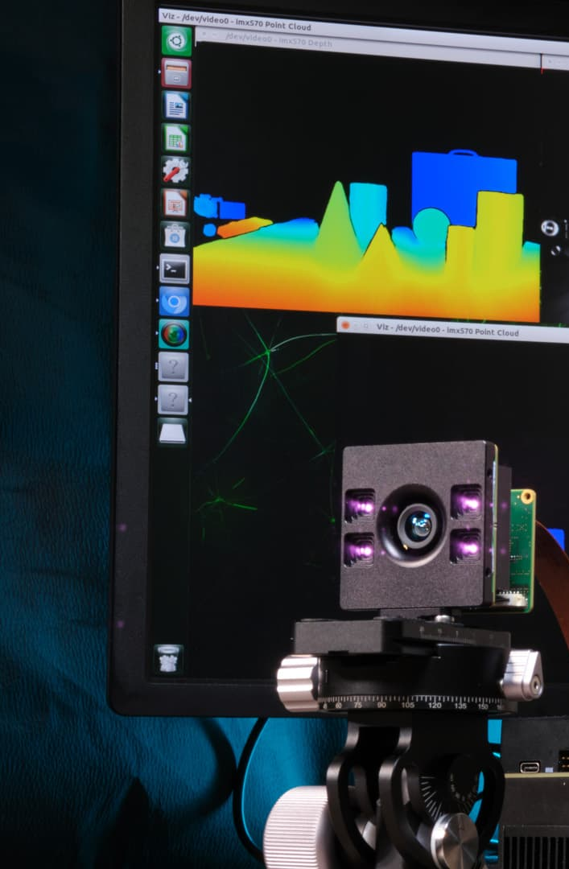
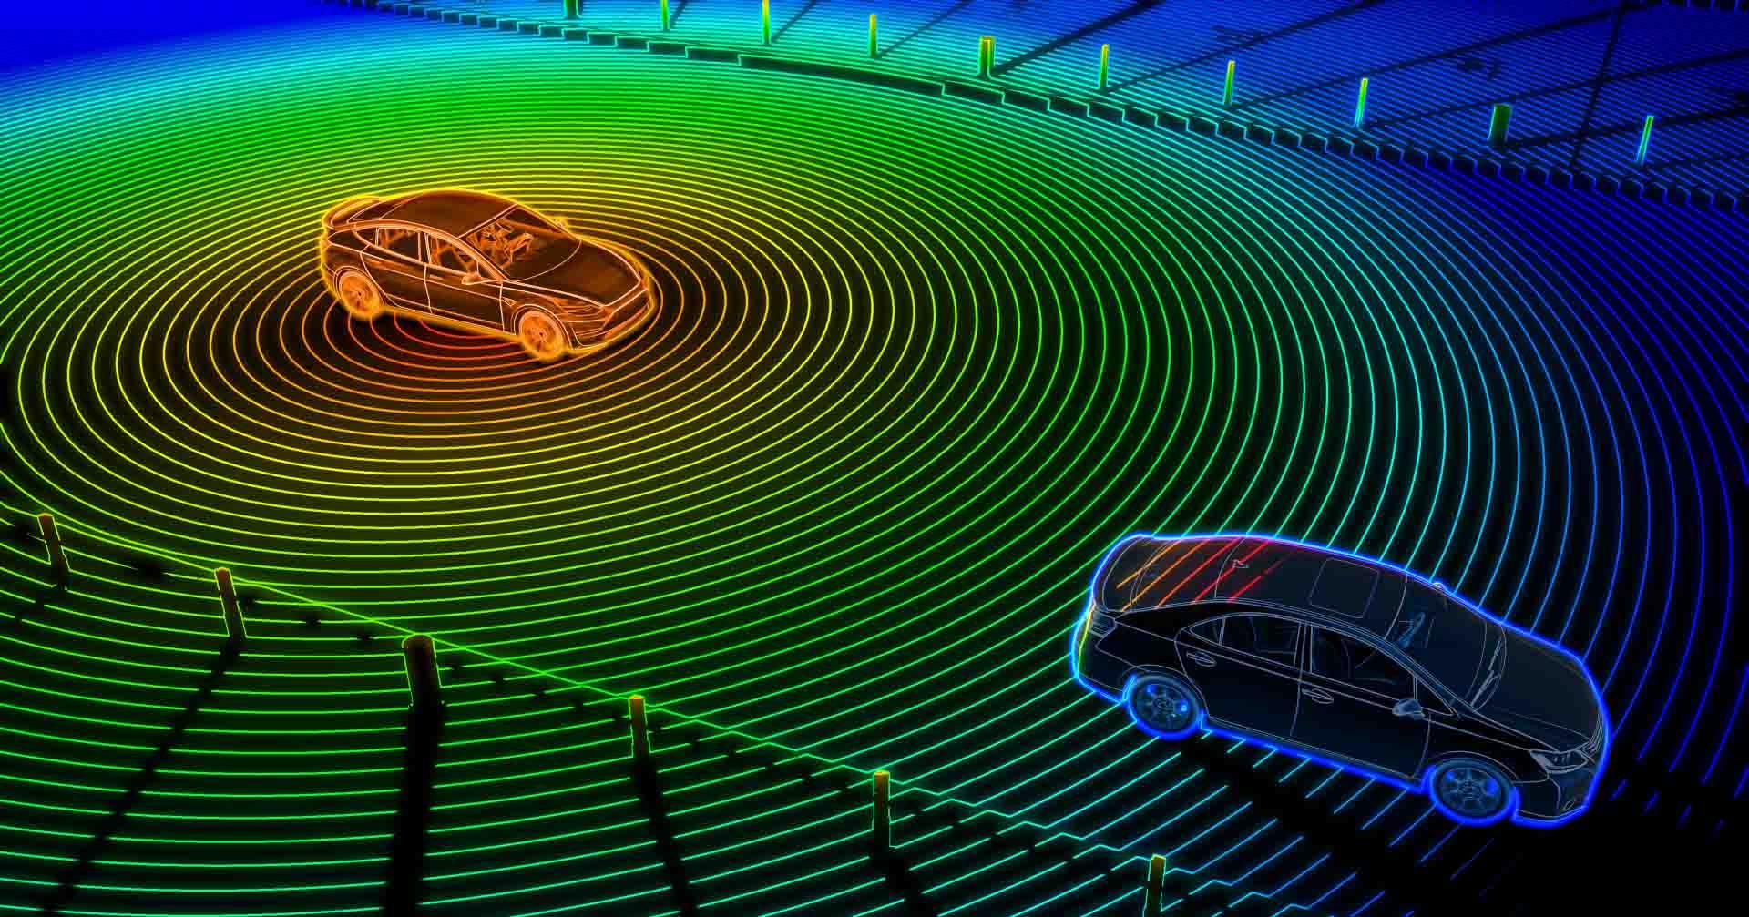
Hardware (Cont.)
Microcontroller: Raspberry Pi Pico 2
Extremely power efficient
UART/Serial port capabilities (as opposed to I2C or SPI)
Python / C/C++ capabilities, access to the Raspberry PI SDK.
Lidar vs. Depth Cameras
Both provide “vision”
Lidar scans surrounding in a cone similar to radar/sonar
Depth camera measures objects in a frontal cone pattern
Rumbler
Haptic feedback will alert the user of nearby objects in the probed direction
Our project plans to utilize multiple types of sensors
Notes:
Jack L

Slide 12
Design Validation
Testing & Integration: 3-4 weeks allotted
Mobility
Weight of entire cane must be less than 2 lb
The cane must be collapsable as per the original design
The cane must easily be moved back and forth.
Full functionality should be available for 3-4 hours
Obstacle Detection
GUIDE will detect obstacles at least 2m away
Detection should be tested in sunny/cloudy/rainy conditions
GUIDE will be functional in grass, pavement, mulch, and dirt.
Detection should be tested on curbs, pedestrians, bikers, scooters, medians
User Alert
User will be alerted within 0.5 seconds of GUIDE algorithm determining obstacle.
Intensity of the vibrations will increase from 2m, 1m, 0.5m and 0m
Notes:
Jack L

Slide 13
Design Validation (Cont.)
Testing environment plan
Create evaluation platform using prototype with breadboard, spare pico, and simulated sensor values
Use this setup for testing while final product is in production
Allows for physical testing of cane, code can still be modified and tested
Incremental testing- a three step approach:
Individual component testing (serial port connectivity, power settings)
Integrated tests of all components together, with a 5V power supply
Full system testing with dedicated battery (final product)
Notes:
Jack L

Slide 14
TEAM MANAGEMENT

Slide 15
Budget
Part Type | Cost | Link | Dimensions | Weight
Walking Stick | $17.99 | Walking Stick - Amazon | 53in x 0.5in - Rod 7in x 1in - Handle | 0.55 lb
Power Button | $9.99 | Power - Amazon | 16mm | 0.35 oz
Vibrating Motor | $7.59 | Vibrating Motor | 10mm x 2.7mm | 0.63 oz
LiDAR | $99.00 | LiDAR - Amazon | 5.1in x 3.9in x 3.1in | 11.2 oz
Depth Camera | $43.00 | Camera - Amazon | ‎3.94in x 1.97in x 1.97in | 10.6 oz
Lithium Ion Battery | $25.99 | 11.1V Battery - Amazon | 57mm x 25mm x 17 mm | 44 g
Supulse Battery Charger | $12.99 | Li Po Battery Charger - Amazon | Not being added to design, used by the user to recharge batteries
Raspberry Pi | $5.00 | Pico 2 | 21mm x 51mm | 4 g
Notes:
Diana

Slide 16
Schedule
MONTH | WEEK | OBJECTIVES
SEPTEMBER | 9/2 | 9/5: Need, Objective, Requirement Statement
 | 9/9 | Finalize parts list and purchase Split up Project Proposal
 | 9/16 | 9/17: Proposal Presentation 9/19: All Hardware Component Choices Finalized and Ordered 9/19: Software Languages, Design Tools, and Version Control Established 9/19: Project Proposal DUE, Peer Review 1
 | 9/23 | 9/26: Weekly Report 9/26: Hardware Location and Implementation Finalized 9/26: Software Prototype Ready for Demo
OCTOBER | 9/30 | 10/3: Weekly Report 10/3: Working Breadboard Prototype Demo 10/3: Software Prototype Fully Functional
 | 10/7 | 10/7 - 10/8 FALL BREAK 10/10: Weekly Report 10/10: Hardware Work Week 1
 | 10/14 | 10/17: Weekly Report 10/17: Hardware Work Week 2
OCTOBER (Cont.) | 10/21 | 10/24: CDR Report, Peer Review 2 10/24: Final Changes and Optimization
 | 10/28 | 10/31: Weekly Report INTERNAL DEADLINE OF COMPLETION
NOVEMBER | 11/4 | 11/7: Weekly Report Integration & Test Buffer week 1 for Hardware Deadline(s) Implement Software on Hardware
 | 11/11 | 11/14: Weekly Report Integration & Test Buffer week 2 for Hardware Deadline(s)
 | 11/18 | 11/21: Weekly Report Integration & Test Final Report Final Presentation
 | 11/25 | THANKSGIVING BREAK 11/26: Project Demos, Peer Review 3 Final Report Final Presentation Package up deliverables
DECEMBER | 12/2 | 12/3: Project Presentations, Final Report, Deliverables
Notes:
Diana

Slide 17
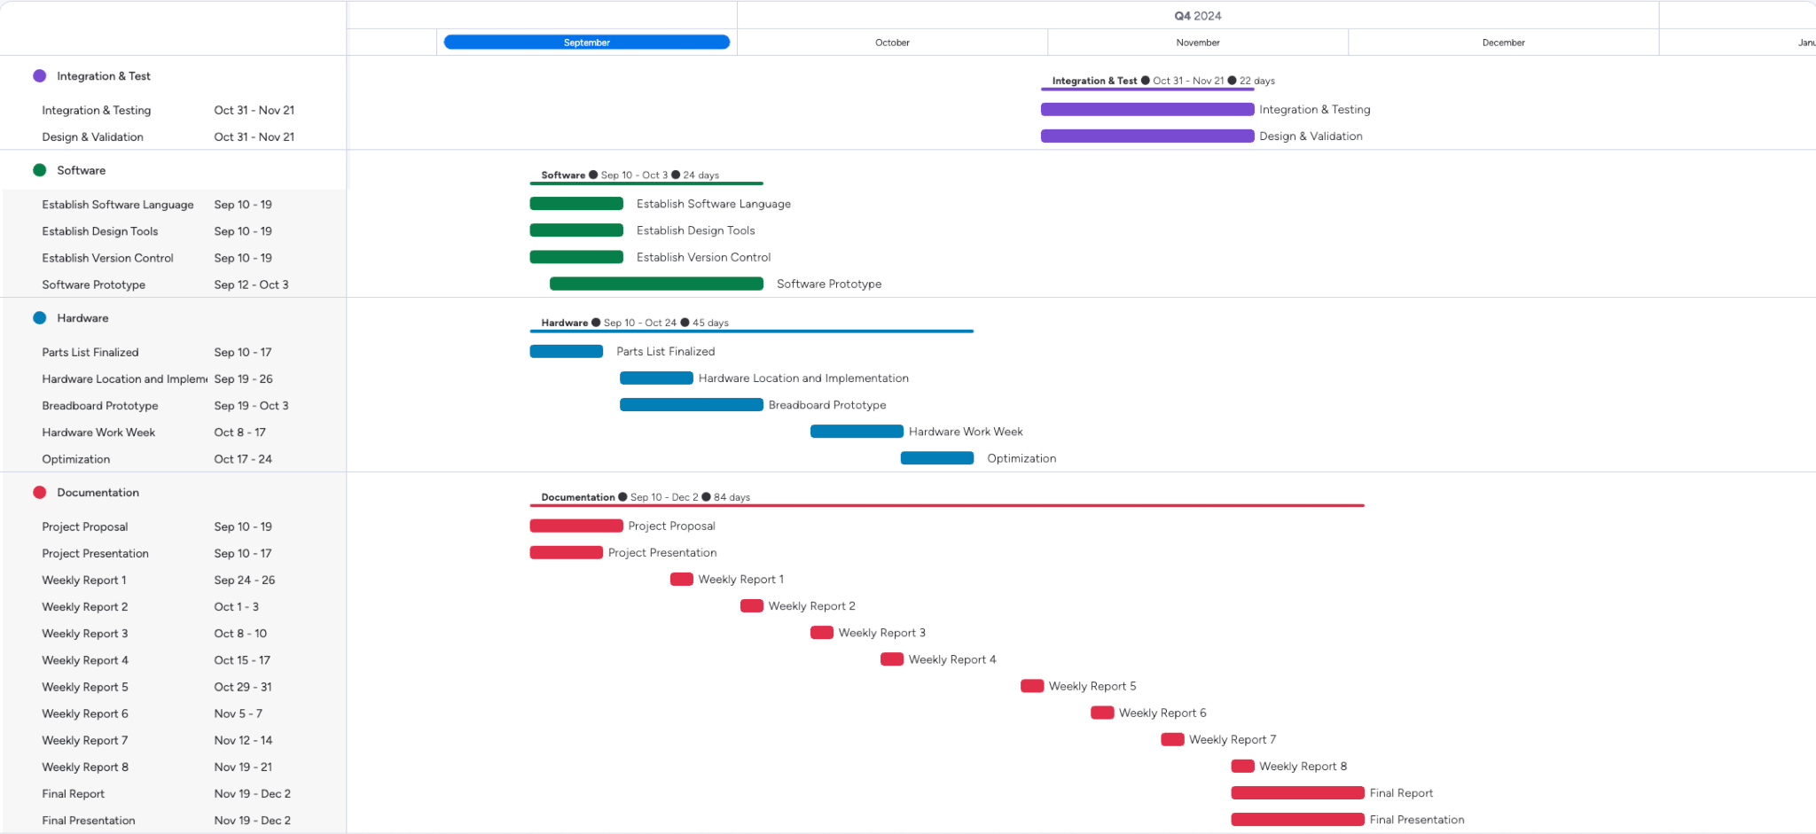
Schedule
Notes:
Diana

Slide 18
Project Management
Team | Leader | Members
Hardware | Jack Letsinger | Ryan Wu Alyan Tharani
Software | Jack Couture | Noah Kilpatrick Diana Canchola
Overall Lead: Diana Canchola
Notes:
Diana

Slide 19
IMPACT

Slide 20
Product Impact Analysis
Increased independence by improving the mobility of users, allowing them to navigate environments such as college campuses easily.
Accident prevention by alerting users real-time of obstacles within 2m distance.
Minimal environmental impact due to it being a personal device powered by commercially available batteries.
Notes:
Jack C
Societal, Safety, and Environmental Impact

